Slide 1





THE APPLICATION OF THE MARKET ECONOMY PRINCIPLE IN PRACTICE
- Key principles from the EU case-law
- Case study
1st Pázmány EU State aid law forum
Budapest, 4 October 2024
Jacques Derenne
Partner, Sheppard Mullin – Brussels & Paris bars
Professor, University of Liège & Brussels School of Competition

Slide 2
Outline
Methodologies
EU case-law
One case study

Slide 3

Assessment methodologies
2016 Notion of aid Notice
Direct
  Competitive Tender
  Pari passu situation
Indirect
  Benchmarking
  Other assessment methodologies :
    IRR (Internal Rate of Return)
    ROE (Return on Equity)
    ROCE (Return on Capital Employed)
    NPV (Net Present Value)
    CAPM (Capital Asset Pricing Model)
    Expert valuation

Slide 4
Takeaways from EU case-law (1)
Q1 - Applicability
  “Is the measure comparable to the conduct of commercial operators?”
If yes: Q2 – Application
  “What would a commercial operator do?”
Nature, subject-matter, context, objective of measure, rules to which the measure is subject
C-341/06 P & C-342/06 P UFEX IV, no MEOP if impossible to compare State’s conduct with private operator (infrastructure no private operator would ever have been able to create)
C-124/10 P Commission v EDF: form of measure (e.g. fiscal) not decisive on its own
C‑278/92 to C‑280/92 Spain v Commission “Hytasa”, para. 22
C-244/18 P Larko, paras 28-32 and 62-70
C-332/18 P Alluminium of Greece, MEOP excluded for judicial decisions
C-701/21 P & C-739/21 P Mytilinaios v. DEI (voluntary) arbitral decision not an aid

Slide 5
Takeaways from EU case-law (2)
“Normal market conditions”
  absence of State interference, not absence of crisis
  T-850/19 Greece v Commission (C-797/22 P, paras 25-28)
    whether beneficiary could have obtained same advantage on the market w/o State intervention, regardless of whether or not the market is facing a crisis situation
Aid defined by effects only (not by cause, objectives)
  C-480/98 Espagne c. Commission, para. 16
  C-706/17 Achema, para. 86

Slide 6
Takeaways from EU case-law (3)
Investments
  Ex ante assessment (information available at the time)
    C-124/10 P Commission v EDF
  Consecutive measures may have to be assessed together (chronology, purpose, circumstances of the beneficiary)
    C-399/10 P and C-401/10 P Bouygues SA et Bouygues Télécom
    T-11/95 BP Chemicals v Commission, paras 170-171
Loans
  Reference rate: proxy for market rate and measure of grant equivalent (GBER, scheme)
  Ratings and collateralisation
  Commission communication (OJ C 14, 19.1.2008, p. 6)

Slide 7
Takeaways from EU case-law (4)
Not whether the transaction at issue is reasonable for the State, but whether it is at normal market conditions.
  T-228/99 and T-233/99 West LB v Commission, para. 315
Rational considerations outside MEOP are for the compatibility assessment (not aid qualification).
  C-579/16 P Commission v FIH Holding, para. 75
  not relevant:
    revenues related to State prerogatives (tax, savings on unemployment benefits)
    positive externalities related to public policy (regional development, industrial / employment policy)
    philanthropic, social considerations
      but see T-565/08 Corsica Ferries v Commission, paras 80-109 (corporate social responsibility - very high threshold, rejected in casu)

Slide 8
Takeaways from EU case-law (5)
Exposure to previous State aid (even if compatible)
  see FIH case above
Burden of proof for MEOP
  Applicability: Member State “must establish unequivocally”
  Application: Commission (wide margin, complex economic assessments in predicting market conduct)
    C-244/18 P Larko, paras 62-65
    C-148/19 P Duferco
    But, cases where "weak" beneficiary v. Commission & Member State : higher Commission's standard of proof
      C-300/16 P Frucona Košice

Slide 9
C-300/16 P Frucona Košice (1)
Slovakia waives 65% of claim against insolvent company but then considers it State aid
Applicability
  Commission must seek ex officio from Member State
    all relevant information
    irrespective of any request for that by third party
  Economic nature of Member State action matters
    not its subjective state of mind
Application
  Burden of proof on Commission
  Standard of proof: manifestly not obtained from market
  Member State’ subjective state of mind is irrelevant
  Complex economic assessment v. judicial review of evidence
  Wide concept of “relevant” and “available” information

Slide 10
C-300/16 P Frucona Košice (1)
See also:
  C 362/19 P, Commission v Fútbol Club Barcelona, para. 62
  C-332/20 P & C-343/20 P – Volotea
  MEOP requires overall, concrete assessment on a case-by-case basis
  Commission must prove the advantage, not the undertakings concerned to show its absence
  the Commission infringed Article 107(1) TFEU:
    failed to apply MEOP
    determined advantage from legal and factual considerations not capable of justifying such a finding
      airport operators not State-owned entities
      public policy objectives
      airport operators merely implemented scheme without autonomy from Autonomous Region
Note: C-244/18 P Larko, diverging views

Slide 11
C-124/10 P, EDF (1)
Recapitalisation of EDF by waiver of tax debts
Commission: no MEOP, tax exemption
GC: MEOP applies
  Form irrelevant: nature, purpose and objective of the measure are decisive
CJEU: confirmation
  mere fiscal nature of the means employed does not exclude MEOP applicability (paras 100 and 108)
  Commission must verify the conditions for MEOP
  information available and foreseeable developments “at the time the decision to invest was taken” (para. 105).

Slide 12
T-747/15, EDF (paras 221 to 248) (1) (new decision of the Commission of 22 July 2015)
State shareholder ≠ State public authority
Applicability MEOP
  if advantage granted by the State as shareholder
Invocability MEOP
  France must establish unequivocally, with objective and verifiable elements, that the measure falls within its capacity as shareholder

Slide 13
T-747/15, EDF (paras 221 to 248) (2) (new decision of the Commission of 22 July 2015)
Investment decision prior to or at the same time as granting the advantage (waiver of tax on conversion of concession into capital contribution)
Proof that this decision was based on economic evaluations
  rational private investor in a situation as close as possible to that of France
  before making the investment to determine the future profitability
Elements contemporaneous with the measure
  no retrospective assessment of the actual profitability
  no subsequent justifications for the choice of process
If these elements exist, the Commission must assess whether State action is as shareholder or as public authority
Nature and purpose of the measure, context, objective pursued and rules governing the measure

Slide 14
T-747/15, EDF (paras 221 to 248) (3) (new decision of the Commission of 22 July 2015)
France / EDF did not show that
  prior to or at the same time as the tax waiver
  the French State had decided to investment by that measure
  Such decision was taken on the basis of prior economic assessments
    comparable to those a rational private investor in a situation as close as possible to that of the Member State in question would have had carried out
    before making that investment, for the purpose of determining the future profitability.
Applicability of MEOP rightly rejected by the Commission:
  overall assessment
  examination of each of the potentially relevant factors
  the measure does not constitute an investment by France in the absence of shareholder considerations established on the basis of objective, verifiable and contemporaneous factors

Slide 15
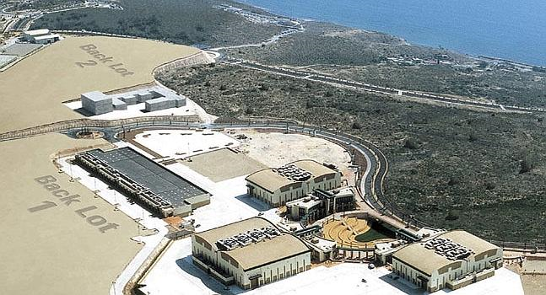

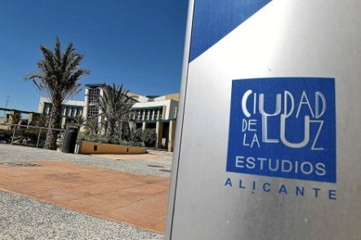
Case study - equity injection: Ciudad de la Luz (2012)
T-319/12 and T-321/12
Public funding to set up a film studio complex in Valencia (Spain)

Slide 16

The market context
Market for EU based big film studios capable to attract international productions
  Intense competition
      4-5 big studios in EU (internal docs)
  Excess capacity (also outside EU)
  Mobility of production
Customers - film production companies
  Fox
  Universal
  Time Warner
  Sony (Columbia Tristar)
  Paramount
  Disney

Slide 17
Ciudad de la Luz - financials
EUR 274 million, no private involvement
Expected return
  business plans (at face value)
  IRR (Internal Rate of Return): measures return over the lifetime of the investment
  IRR of project 8,84% (for 2000 business plan) and 5,74% (at face value, 2004)
Enough for a private investor?
Comparison required with the cost of capital
  Opportunity cost of capital = the return that could be achieved by an investor on alternative investments with equivalent risk
If IRR > cost of capital, a private investor would indeed go for the project

Slide 18
Opportunity cost of capital
In this case: project fully equity financed
Cost of equity estimated by the Commission on the basis of standard CAPM model (Capital Asset Pricing Model):
the sum of the “risk free rate” plus a premium reflecting the riskiness of the investment (proxied by the market risk premium x the “beta factor” for the investment)

Slide 19
Opportunity cost of capital (cont’d)
Quite some divergence in CAPM estimates …
 | Commission’s estimate | Spain’s estimate
Risk free rate (10 year gov. bonds in Spain, 2004) | 4.1% | 4.1%
Market risk premium | 6.8% | 4%
Beta | 1.5-1.68 (based on investment reports on two direct competitors) | 0.38 (based on data extractions financial database)
Cost of equity | ≈ 14% | ≈ 5%
Source: Commission Decision, cost of capital analysis for 2004 business plan. Commission estimate of cost of capital for 2000: 16,66%

Slide 20
Sensitivity analysis
Commission checked cost of capital estimate with historic accounting returns (ROCE) for different peer groups in the period 2000-2007
Historic accounting returns ≠ forward looking cost of capital, but still a useful exercise
Historic accounting returns found to be in the range of [10.1 - 12.26]%

Slide 21
General Court upheld the negative decision T-319/12 & T-321/12
Methodology:
  average return of the sector only indicative: go deeper into the context
  “CAPM approach” valid
  consultant reports not enough; private investor should critically review
  sensitivity tests, comparability of the benchmarks
  margin of appreciation by the State: “return side” instead of “cost of capital” side
Choice of parameters:
  Commission correct on average market risk premium (right time periods and Spain)
  Commission correct in basing its estimate of beta on investment reports on two close competitors
  Spain’s estimate of beta (0,38) cannot be correct. It signals a risk profile that is even lower than the market average
Business plan:
  Commission took business plan of Ciudad de la Luz at face value
  Commission was wrong not to take into account the possible ancillary revenues from the hotel and services activity of Ciudad de la Luz (however, these extra profits would not have made a difference).

Slide 22

