Slide 1
State aid policy: looking back and ahead
1st Pázmány EU State Aid Law Forum
4 October 2024
Karl Soukup
European Commission
DG Competition
The views expressed in this document are those of the author and may not in any circumstances be regarded as stating an official position of DG Competition or of the European Commission.

Slide 2
Looking back: challenging times
Challenging years for policy work and enforcement:
Extensive review of policy framework.
Accompanying (new) Commission priorities: Green Deal, digital strategy, strategic autonomy.
Dealing with Covid and Ukraine crises.

Slide 3
Looking back: review of State aid rules
A lot has been achieved in the last years:
RAG, IPCEI Communication, MFF GBER, CEEAG, RDI Framework, Broadband GL, Fishery Guidelines, FIBER, Agricultural GL, ABER, Enforcement Notice, Recovery Notice, Enabling Regulation, Green Deal GBER, Fishery De minimis Regulation, De minimis Regulation, SGEI De minimis Regulation.
Crisis frameworks: TF and TCTF.
[Foreign Subsidy Regulation.]
Some projects still ongoing.

Slide 4
Looking back: crisis response
Temporary Framework for the Covid-19 outbreak.
Last parts expired end-2023.
Overall 1420 decisions, covering 1023 measures and more than EUR 3,050 billion of aid.
Temporary Crisis and Transition Framework for the Russian aggression against the Ukraine:
By 10.9.2024, 523 decisions covering 388 measures and more than EUR 811 billion of aid.
Partly expired, partly still in force.
Support for the agricultural and fishery sectors.
Accelerated deployment of renewable energy production and quicker decarbonisation of industry: sections 2.5 and 2.6.
Investments into production capacity in sectors which are of strategic importance for the transition: section 2.8.

Slide 5
Looking back: semiconductors
Communication on A Chips Act for Europe:
In the Communication of 8.2.2022 the Commission explains how it will apply Article 107(3)(c) directly to investments in the semiconductor sector.
By now four decisions adopted:
October 2022: EUR 300 million of aid for STMicroelectronics in Italy for and investment of EUR 730 million.
April 2023: EUR 2.9 billion of aid for a joint project of GlobalFoundries and STMicroelectronics with investments of EUR 7.4 billion in France.
May 2024: EUR 2 billion of aid for STMicroelectronics for another investment of EUR 5 billion in Italy.
August 2024: EUR 5 billion of aid for a project of TSMC, Bosch, Infineon and NXP with investments of more than EUR 10 billion in Germany.
Further cases are in the pipeline.

Slide 6
Looking back: IPCEIs
Large integrated innovative cross-border projects.
Gained momentum in the last years.
10 integrated IPCEIs approved by now: microelectronics, batteries, hydrogen, cloud, health.
22 Member States, 283 undertakings with 335 projects, EUR 37.2 billion of aid, triggering EUR 66 billion of further private investments.
Joint European Forum on IPCEI, to improve together with Member States further the functioning of the instrument.

Slide 7
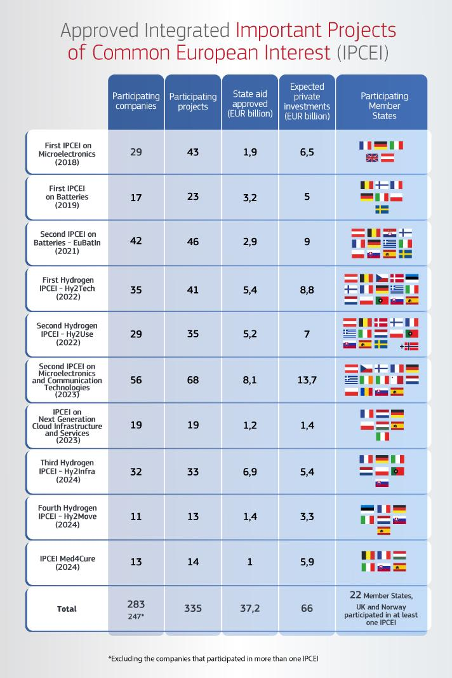
Looking back: IPCEIs

Slide 8
Looking ahead: policy review
Some projects are pending or planned.
Banking Communication.
Guarantee Notice.
Maritime and Land Transport Guidelines.
Maritime and Land Transport Block Exemption Regulation.
Aviation Guidelines.
GBER.
Etc.

Slide 9
Looking ahead: potential areas for initiatives
Temporary Crisis and Transition Framework:
Section 2.1 (limited amounts of aid) for agriculture and fishery expires end-2024.
Sections 2.5, 2.6, 2.8 expire end-2025.
Mission Letter for Executive Vice-President-designate Ribera:
State aid framework to accelerate the roll-out of renewable energy, deploy industrial decarbonisation and ensure sufficient manufacturing capacity of clean tech (as part of Green Industrial Deal).
Simplification of State aid.
Revise State aid rules to enable housing support measures.
Support proposals for IPCEIs and make IPCEI review simpler and faster.

Slide 10

Thanks for your attention!
© European Union 2020
Unless otherwise noted the reuse of this presentation is authorised under the CC BY 4.0 license. For any use or reproduction of elements that are not owned by the EU, permission may need to be sought directly from the respective right holders.

