Slide 1
State aid enforcement in Romania – a proper tool for sustainable development
László Gyerkó
Budapest
4 October 2024

Slide 2
Topics
Supporting business: Government tools
State aid – an instrument at hand
State aid in EU
Romania – state aid policy after accession (national and local level)
Industrial policy vs. competition policy
Competition Council - a dual role

Slide 3
Supporting business: Government tools (1)
Administrative instruments:
Regulatory Simplification.
Educational System.
Health System.
Judicial System.
Antitrust Agency.
Infrastructure Investments.
Public Procurement Programs.
Access to Export Markets.

Slide 4
Supporting business: Government tools (2)
State aid:
Tax Incentives.
Grants, Subsidies or Capital infusion.
Loan Guarantees.
Business Advisory Services.
Workforce Development Programs.
Research and Development and Innovation (R&D&I) Support.
Small Business Assistance Programs.

Slide 5
State aid – an instrument at hand (1)
State aid - a versatile and vital tool for governments to support businesses, drive innovation, and achieve policy objectives, while the EU rules ensure that aid is used responsibly and effectively.
Financial Support for Businesses.
Encourages Regional Development.
Promotes Innovation and Research.
Supports Job Creation and Retention.

Slide 6
State aid – an instrument at hand (2)
Boosts Small and Medium-Sized Enterprises.
Environmental and Sustainability Initiatives.
Crisis and Recovery Tool.
Facilitates Infrastructure Development.
Fosters Competitiveness.
Complies with EU State Aid Regulations.
Public-Private Partnerships.

Slide 7
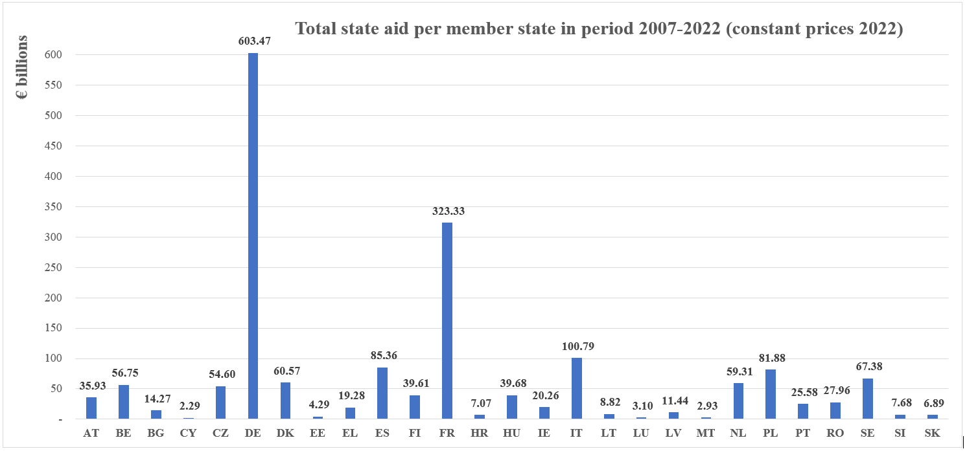
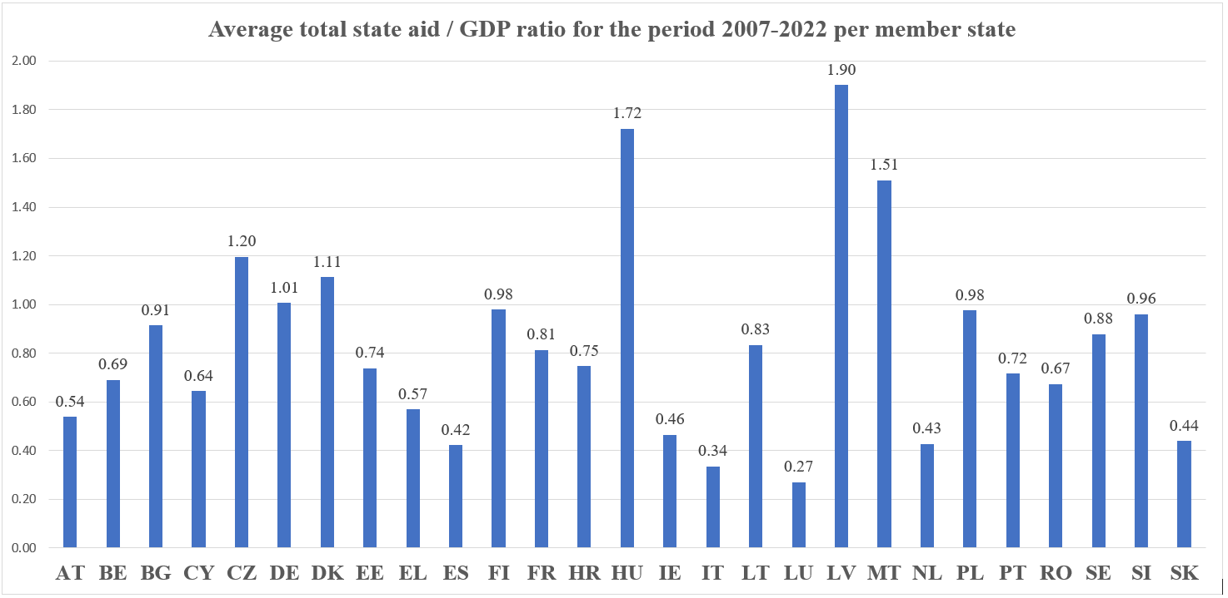
State aid in EU (1)
Source – EC Scoreboard State aid data

Slide 8
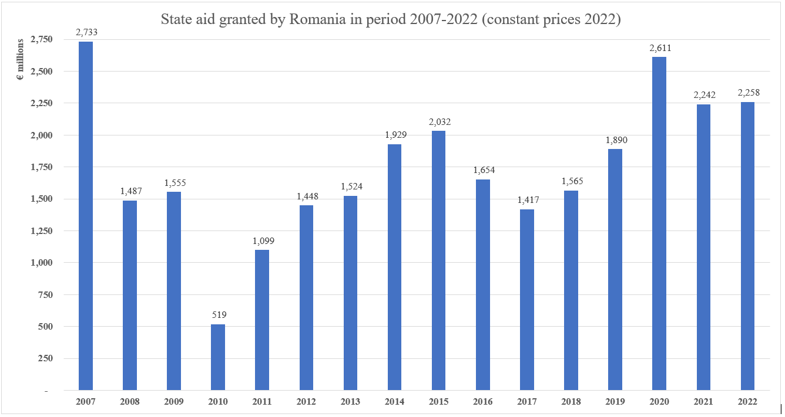
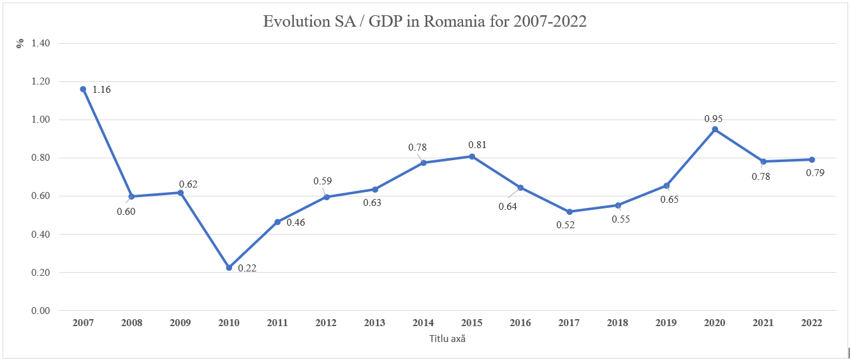
Romania – state aid policy after accession (1)
Source – EC Scoreboard State aid data

Slide 9
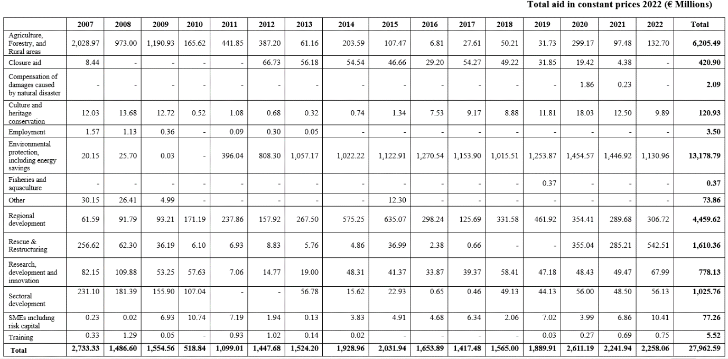
Romania – state aid policy after accession (2)
State aid granted in Romania during 2007-2022 per objectives:
Source – EC Scoreboard State aid data

Slide 10
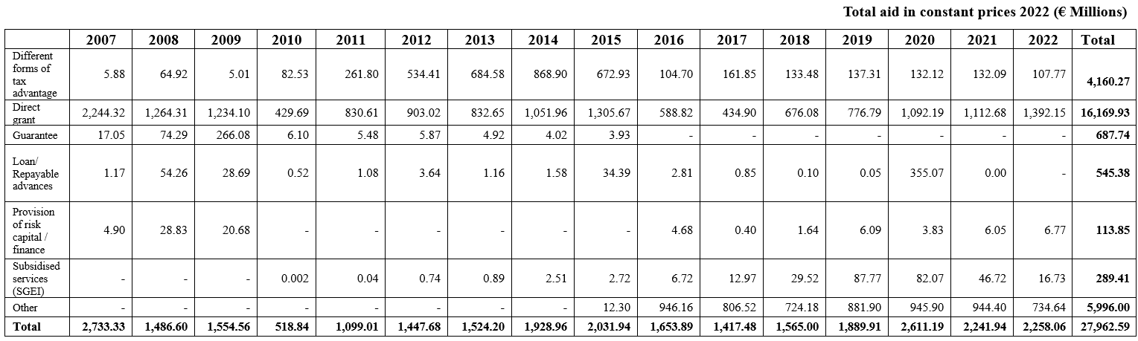
Romania – state aid policy after accession (3)
State aid granted in Romania during 2007-2022 per instruments
Source – EC Scoreboard State aid data

Slide 11
Romania – state aid policy after accession (4)
National level:
Regional development:
In the period from 2007 to 2023, the Ministry of Finance supported the business environment by running the multi-annual Program "State aid for the financing of investment projects“ (GBER – art. 14 Regional development):
- 291 investment projects were approved for financing,
- which amount approx. EUR 7.43 billion,
- which generates over 57,000 new jobs,
- which have a direct contributions to regional development through (contributions and taxes) over 4 billion Euros,
- with state aid of maximum EUR 2.37 billion.

Slide 12
Romania – state aid policy after accession (5)
National level:
Regional development:
MoF’s "State aid for the financing of investment projects":
The sectors of activity financed:
• automotive industry
• aeronautical industry
• food industry
• production of household appliances
• medical/wellness and pharmaceutical services
• production of machines and equipment
• hotel industry
• construction materials industry
• paper industry
• recovery of recyclable materials
• IT&C

Slide 13
Romania – state aid policy after accession (6)
National level:
Regional development:
MoF’s "State aid for the financing of investment projects":
The economic impact:
• The creation of new jobs directly at the level of beneficiary companies and indirectly, at the local level, at the level of suppliers / beneficiaries of goods and services;
• Contributions to the general consolidated budget and local budgets as a result of the investments;
• Multiplier effect (indirect contributions to the consolidated general budget and local budgets by involving other local companies - suppliers / beneficiaries);
• Contributions to Romania's import/export balance;
• Consolidation of some industrial branches with tradition in Romania;
• Industrial know-how ;
• Specialization and training of highly qualified personnel;
• Increasing the welfare of the population.

Slide 14
Romania – state aid policy after accession (7)
National level:
Digital Transformation:
Adapting to the digital era - a key challenge for Romanian businesses.
State aid helps accelerate digitalization and technological innovation, ensuring competitiveness in international markets.
Examples of state support include state aid schemes and programs like the National Recovery and Resilience Plan (PNRR), which support digital transition.

Slide 15
Romania – state aid policy after accession (8)
National level:
Energy Independence and Green Transition:
Energy Efficiency and Renewable Energy.
Supporting Biogas, Biomass and Green Hydrogen .
Energy Efficiency in Public Buildings.
Promotion of electric vehicle recharging infrastructure.
Specialized Training for Energy Efficiency.
Supporting national and EU Programs: the Modernization Fund, Just Transition Operational Program, and National Recovery and Resilience Plan provide financial support for the modernization of energy systems, the promotion of clean energy technologies, and the decarbonization of industries.
The ElectricUp program: installation of:
- photovoltaic panel systems for the production of electricity (for own consumption)
- storing system of the energy produced to increase the degree of self-consumption
- at least one recharging station of at least 22 kW for electric and plug-in hybrid electric vehicles
- alternative heating/cooling system.

Slide 16
Romania – state aid policy after accession (9)
Local level:
Digital Transformation:
Public measures for the local business environment for digital transition, implemented by the 8th Regional development agencies.
De minimis aid scheme regarding digitization for the benefit of SMEs, non-governmental organizations.
Energy Independence and Green Transition:
Negative context:
the high costs of implementing green technologies
low access to financing
low return on investment
energy price fluctuations
Solutions:
Investments in new capacities or in the modernization of existing capacities for the production of electricity/thermal energy from:
biomass
biogas
geothermal water,
solar energy

Slide 17
Industrial policy vs. competition policy
Geopolitical challenges, technological developments, and crises emerge
Nations re-evaluate industrial policy
Governments support their industries
negative market distortions
protection of inefficient firms
entrenchment of monopolies
fostering competition
supporting sectors that have the potential to drive future economic growth
creating favorable conditions for new market entrants
supporting SMEs
Industrial policy (government interventions aimed at improving the structural performance of the domestic business sector) can both complement and conflict with competition policy.

Slide 18
Competition Council - a dual role
Competition authorities have the crucial task of ensuring that industrial policies are designed in a way that supports and enhances market competition rather than distorting it.
The balance between negative and positive effects on competition is vital for maintaining the dynamism of markets, which is essential for innovation and long-term economic growth.
Competition authorities have a dual role.
First, they act as advisors in the design of industrial policies, ensuring that these policies are pro-competitive. This advisory role is critical in sectors where government intervention is deemed necessary, such as in emerging technologies or in industries affected by global crises. By embedding competition principles into the design of industrial policy, authorities can help mitigate the risks of market distortion and ensure that government interventions do not stifle innovation or reduce market efficiency. | Second, competition authorities are responsible for enforcing competition laws in sectors targeted by industrial policy. Effective enforcement ensures that these sectors remain competitive, even in the presence of government intervention. This enforcement role is particularly important in industries where the risk of anti-competitive behaviour is high, such as in markets with significant government subsidies or where there is a tendency toward natural monopolies.

Slide 19
Competition Council - a dual role
The global nature of today's markets adds another layer of complexity to the relationship between industrial policy and competition policy.
Actions taken by one jurisdiction can have significant implications for global competition, especially in highly interconnected industries.
As such, there is a need for international coordination among competition authorities to ensure that industrial policies implemented in one country do not create unfair advantages in global markets.
In conclusion, the role of competition authorities in reconciling industrial policy with competition principles is more critical than ever.
As governments increasingly turn to industrial policy to address modern economic challenges, the expertise of competition authorities will be indispensable in ensuring that these policies are designed and implemented in a way that fosters, rather than hinders, competitive markets.
This delicate balancing act will be key to achieving sustainable economic growth in the years to come.

Slide 20
Thank you for your attention!
László GYERKÓ
Romanian Competition Council, Competition Councilor,
member of the RCC Board laszlo.gyerko@consiliulconcurentei.ro

